Slide 1
Sorting Algorithms & Time Complexities
By: Matthew Franco CS 131 Discrete Structures for Computer Science
Spring 2022

Slide 2
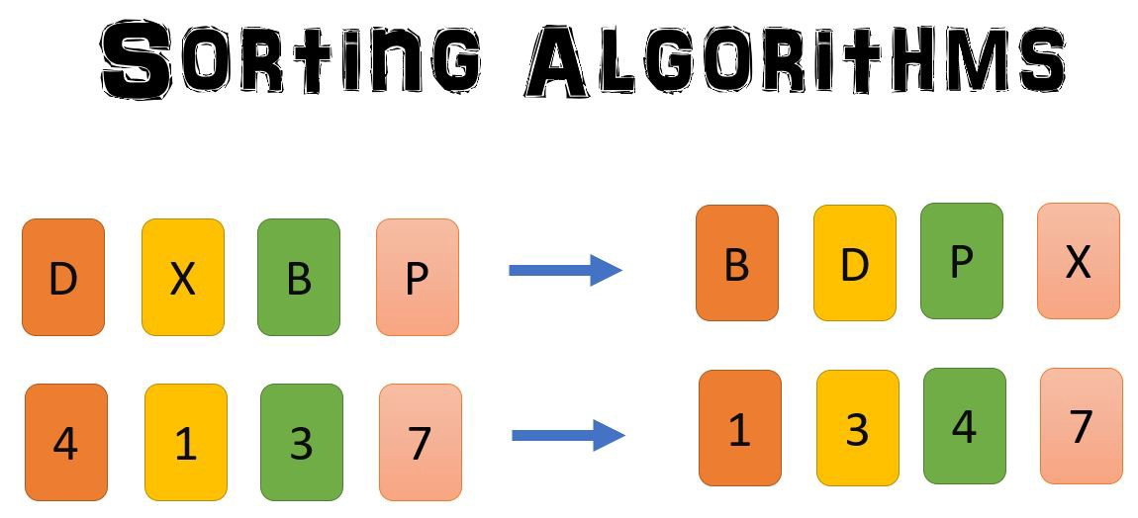
What is a Sorting Algorithm?
A method to reorganize any number of items into a specific order.
Alphabetical, Increasing, Decreasing, Longest, Shortest, etc.
Takes a list of items as input data, performs operations and outputs the sorted list.
Lists: Arrays, Vectors, Linked Lists, etc.

Slide 3
When & Where is a Sorting Algorithm used?
Sorting Algorithms can be used whenever and wherever!
Programming & Coding: it can be used to sort lists to help decrease running time when used in conjunction with another algorithm.
Everyday Life: you can sort clothes, cards, money, books, and practically anything you can think of! This can help keep those lists of objects looking neat and reduce the time you will need to look for an object within the sorted list.

Slide 4
Sorting Algorithms (To Be Discussed)
Bubble Sort
Insertion Sort
Selection Sort
Merge Sort
Quick Sort

Slide 5
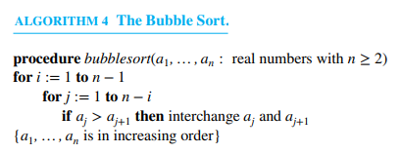
Bubble Sort
How it works:
Simple Algorithm
Repeatedly swaps the adjacent elements if the first element is greater than the second. Sorting stops when the final iteration confirms that all numbers are in the right order.
Time Complexity
Best Case: Ω(n)
Average: ϴ(n ²)
Worst Case: O(n ²)

Slide 6
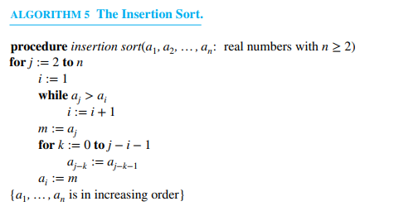
Insertion Sort
How it works:
Simple Algorithm
Goes through each element until it reaches the end of the list. If the element is in the right place, it is marked as sorted. Otherwise, the element is placed in the correct position.
Time Complexity
Best Case: Ω(n)
Average: ϴ(n ²)
Worst Case: O(n ²)

Slide 7
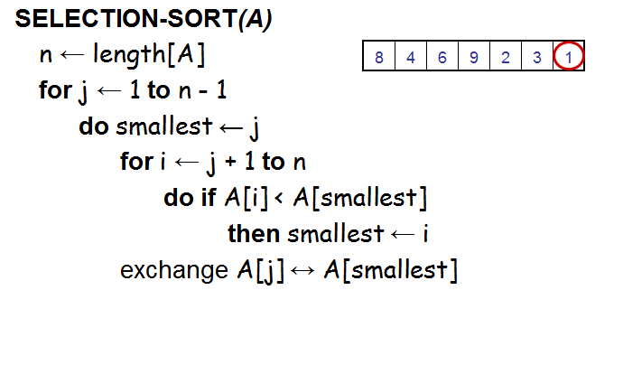
Selection Sort
How it works:
Repeatedly finds the lowest element from the unsorted elements.
Two subarrays are used for the sorted & unsorted elements.
Places the lowest element into the sorted subarray.
Time Complexity
Best Case: Ω(n ²)
Average: ϴ(n ²)
Worst Case: O(n ²)

Slide 8
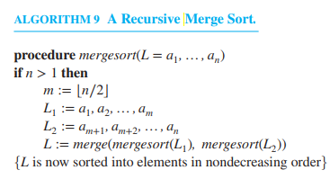
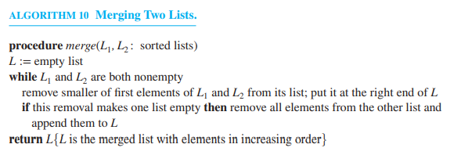
Merge Sort
How it works:
Divide & Conquer Algorithm
Divide the problem into sub-problems
Conquer the sub-problems recursively
Combine the conquered sub-problems to get the whole solution
Divides the list into two halves, and then merges the two sorted halves.
Time Complexity
Best Case: Ω(nlog(n))
Average: ϴ(nlog(n))
Worst Case: O(nlog(n))

Slide 9
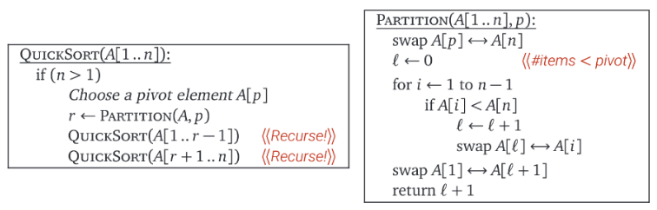
Quick Sort
How it works:
Divide & Conquer Algorithm
Selects a pivot element and recursively partitions the list surrounding the pivot element.
Swaps elements between the partitioned list & combine into list.
Time Complexity
Best Case: Ω(nlog(n))
Average: ϴ(nlog(n))
Worst Case: O(n ²)

Slide 10
“Sorting Algorithms.” GeeksforGeeks, 22 Apr. 2022, https://www.geeksforgeeks.org/sorting-algorithms/.
Rosen, Kenneth H. Discrete Mathematics and Its Applications. 8th ed., McGraw-Hill Education, 2019.
Works Cited:

Slide 11
End of Presentation
Thank you for your attention!

